Slide 1


JAVA PROJECT BATCH
GUI Programming
Lecture-8

Slide 2
Today’s Agenda
01
The JList Component.
02
Selection Mode
03
Methods of JList.
05

Slide 3
The JList Component
The JList component in java is mainly use to display a scrolling list of items to the
user amongs which we can select one or more items.
Properties Of "JList“:
1. model: For setting items to be displayed in the JList
2. visiblerowcount: For settings no of items to be displayed by default in the JList
3. selectionMode: For setting selection mode which allows the user to select one or
more items.Possible values are SINGLE_SELECTION,SINGLE_INTERVAL_SELECTION,MULTIPLE_INTERVAL_SELECTION

Slide 4
Practical Implementation Of JList
You will see the list as usually in the palette, drag and drop the list to the
frame.
Netbeans will provide some dummy items in it which we have to edit by
right click and go to properties.
There you will see model property then click to open custom editor. As
shown below:

Slide 5
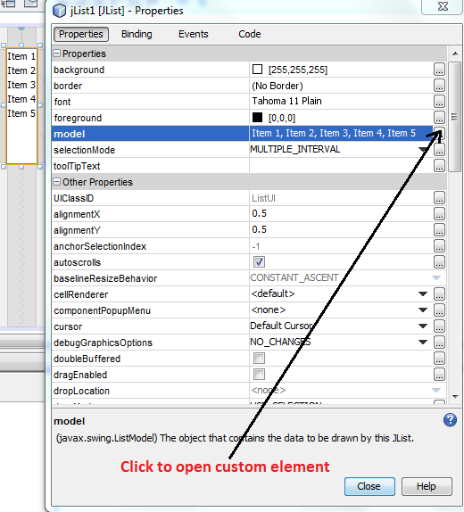
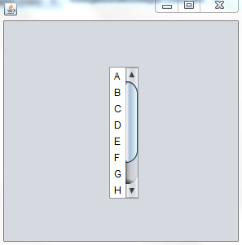
Practical Implementation Of JList
Now enter some items
which is to be displayed
as a choice.
Now run the code.

Slide 6
Selection Mode
The selection mode defines the way elements can be selected. There are totally 3 selection modes
available to be set for JList:
SINGLE_SELECTION:
This mode specifies that only a single item can be selected at any point of time.
SINGLE_INTERVAL_SELECTION:
This mode specifies that multiple items can be selected, but they have to be contiguous. Items
can be selected contiguously by pressing down the shift key and selecting elements with the mouse.
MULTIPLE_INTERVAL_SELECTION:
This mode is the default mode. This mode specifies that multiple items can be selected and they may or may not be contiguous.

Slide 7
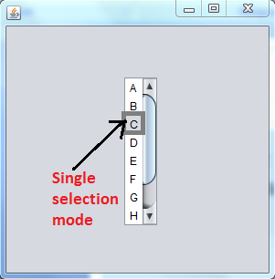
Example
For Example:-
Let us now run the program and select single items.
We get the following output:

Slide 8
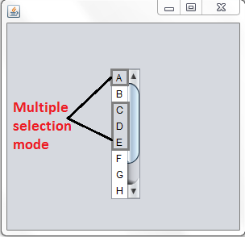
Example
Let us now try and change the selection mode to multiple selection items. We will hold down the shift key and click with mouse to select contiguous items. For
non-contiguous items, we need to press down the ctrl key and select with the
mouse.
We get the following output:

Slide 9
Methods Of JList
public int getSelectedIndex( ):- Returns the index of first selected item of the list.
public int[ ] getSelectedIndices( ):- Returns an array of all of the selected indices, in
increasing order.
public Object getSelectedValue( ):- Returns the first selected value of the element of the list.
public Object[ ] getSelectedValues( ):- Returns an array of all of the selected values.
public void setVisibleRowCount(int):- Changes the visibleRowCount property.

Slide 10
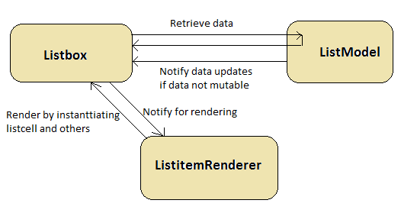
Adding Items Dynamically In List
The class JList does not has methods for adding or removing items into it . Rather we use DefaultListModel class for adding/removing items from the JList.
DefaultListModel provides a simple implementation of a list model, which can be
used to manage items displayed by a JList control.

Slide 11
Adding Items Dynamically In List
1. We first create an instance of DefaultListModel:
DefaultListModel dlm=new DefaultListModel();
2. We then set the DefaultListModel as the ListModel object for JList by calling the JList method setModel()
jList1.setModel(dlm);
3. We then add several items of the String type to the created data model and doing this automatically adds
the data to JList also.
String [] colors={"Red","Green","Yellow","Orange","Pink","White","Black","Magenta"};
for(String s:colors)
{
dlm.addElement(s);
}

Slide 12
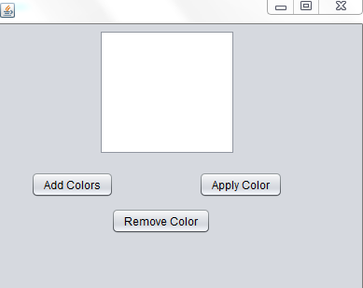
Example
Develop an application, change the background color of the frame according to
the user’s choice as shown below:

Slide 13
Example
Solution:-
public class JListDemo extends javax.swing.JFrame {
Color[] myColors=new Color []{Color.red,Color.green, Color.blue, Color.yellow, Color.orange, Color.black, Color.white, Color.pink, Color.magenta};
DefaultListModel dlm=new DefaultListModel();
public JListDemo() {
initComponents();
jList1.setModel(dlm);
}
private void jButton1ActionPerformed(java.awt.event.ActionEvent evt) {
String[] colors={"red","green","blue","yellow","orange","black","white","pink","magenta"};
for(String s:colors){
dlm.addElement(s);
}
}

Slide 14
Example
private void jButton2ActionPerformed(java.awt.event.ActionEvent evt) {
int index=jList1.getSelectedIndex();
dlm.removeElementAt(index);
Color [] newColors=new Color[myColors.length-1];
for(int i=0,j=0;i<myColors.length;i++)
{
if (i!=index)
{
newColors[j]=myColors[i];
j++;
}
}

Slide 15
Example
myColors=newColors;
Color originalColor = null;
jPanel1.setBackground(originalColor);
}
private void jButton3ActionPerformed(java.awt.event.ActionEvent evt) {
int colorindex=jList1.getSelectedIndex();
jPanel1.setBackground(myColors[colorindex]);
}

Slide 16
Thank you

